Slide 1
Strings

Slide 2
Strings
Strings are used to store and manipulate text.
Strings are the sequence of character enclosed within the single quotes(‘), double quotes(“), or backticks(`)
Strings can be created using the following the syntax
let name1 = “John”;
let name2 =‘Abin’;
let name3 =`Vrindha`

Slide 3
Template literals
Template literals use backticks instead of quotes to define a string
let name=`John`
With template literals ,It is possible to use both single as well as double quotes inside a string
let sentence=`The name “is” Hari’s `
We can insert variables directly in template literals this is called String interpolation
let a= `This is ${name}` //prints This is Hari

Slide 4
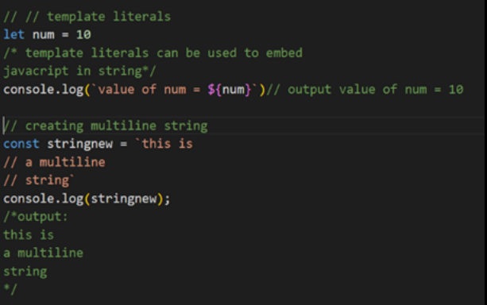
Template literals

Slide 5
Escape Sequence Characters
let text = “This is my “new" car.";
JavaScript will misunderstand this string:
The solution to avoid this problem, is to use the backslash escape character.
The backslash (\) escape character turns special characters into string characters:
let text = " This is my \" new \" car.";
let text = "The character \\ is called backslash.";

Slide 6
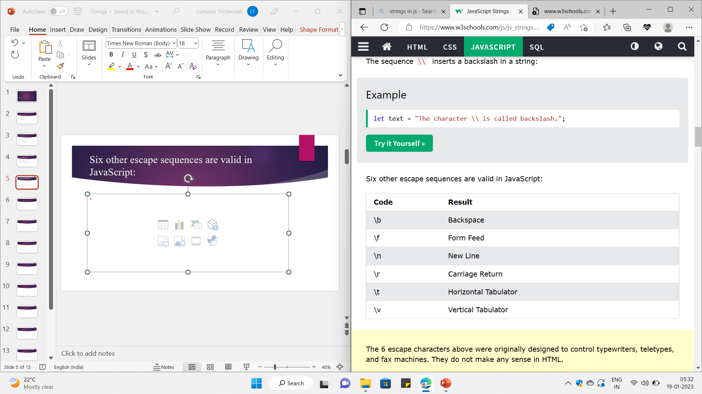
Six other escape sequences are valid in JavaScript:

Slide 7
String concatenation
We can concatenate two or more string using ‘+’ symbol
We Already discussed in the previous class.

Slide 8
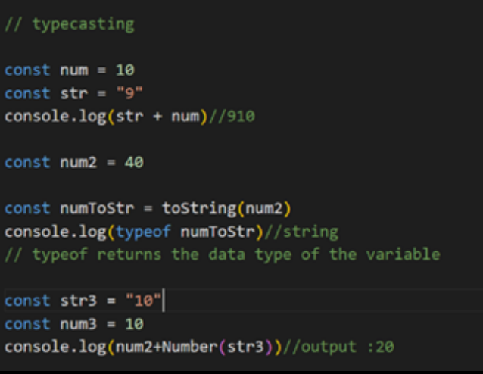
Type casting
Number will be typecast into string we can also use toString() to change Number into String Number() can be used to change string to Number

Slide 9
String Properties and Methods
let sname = "Manu"
console.log(sname.length); //Prints the length of the string
console.log(sname.toUpperCase());//prints MANU
console.log(sname.toLowerCase());//prints manu

Slide 10
Access String Characters
You can access the characters in a string in two ways.
1. One way is to treat strings as an array. For example,
const a = 'hello’;
console.log(a[1]); // "e“
2. Another way is to use the method charAt(). For example,
const a = 'hello’;
console.log(a.charAt(1)); // "e"

Slide 11
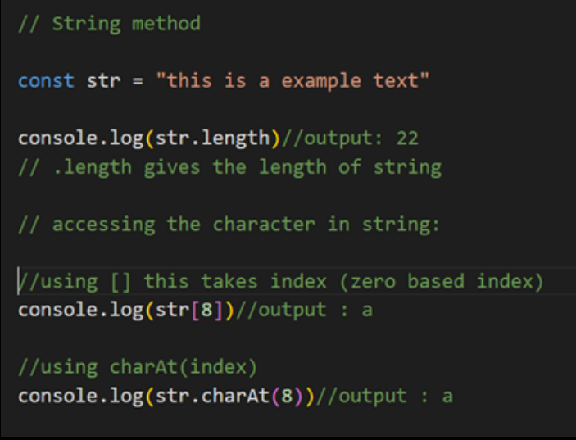

Slide 12
String Properties and Methods
let name1 ="Ann M"
let newname = name1.replace("M","Luka")
console.log(name1); //Ann M
console.log(newname);//Ann Luka
let s_name ="Sagar"
let m_name="Alias"
let l_name="Jacky"
let full_name=s_name.concat(m_name+l_name)
console.log(full_name);//SagarAliasJacky

Slide 13
Tasks
1 What will be output the following print statement in js
console.log("hari\"".length) 2 Explore the includes, startswith and endswith function of a string 3 Extract the amount out of the string
"Please give Rs 10000"
4 Try to Change 4th character of a given string
"Where you able to do it?"
5 Note on All string methods with programs
Continue to next slide…

Slide 14
Tasks
6 Write a function to check if two strings are anagrams of each other. Anagrams have the same characters but in a different order. For example, "listen" and "silent" are anagrams.
7 Write a function to count the number of vowels and consonants in a given string.
8 Write a function that capitalizes the first letter of each word in a sentence. For example, "hello world" should become "Hello World.“
9 Implement a function to perform basic string compression using the counts of repeated characters. For example, the string "aabcccccaaa" would become "a2b1c5a3.“
10 Implement a basic string compression without creating a separate function. Use loops and conditional statements to create the compressed string.

